Slide 1

Banking
Console-Based Interface
By Aravind S

Slide 2
Key Features
?? Digital Transformation: Embracing the era of digital banking, our system leverages cutting-edge technology to offer convenient and efficient services to customers.
💳 Account Management: Explore how our Banking System empowers users to create, manage, and monitor their accounts with ease.
💸 Transaction Processing: Learn about the secure and swift processing of financial transactions, including deposits, withdrawals, and fund transfers.
🔐 Security Measures: Discover the robust security features implemented to safeguard customer data and ensure the integrity of financial operations.

Slide 3
Introduction
Banking Systems, where finance meets innovation! In this presentation, we explore the fundamental concepts and functionalities of a modern Banking System. From managing accounts to facilitating transactions, our Banking System ensures a seamless and secure financial experience for all users.

Slide 4
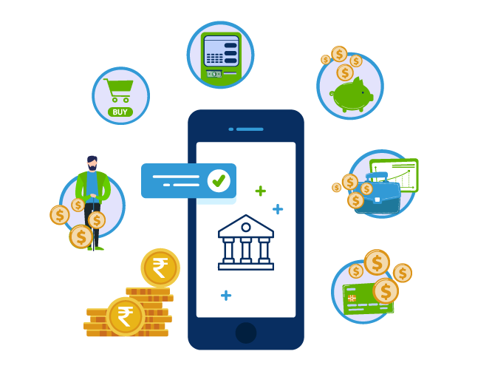
Features and Functionality
The Banking interface console based application comes with a range of features and functionalities that make it easy for customers to use. The software has a simple and intuitive interface that allows customers to navigate through the different options easily.
Customers can perform various transactions using the application such as cash withdrawals, balance inquiries, and fund transfers. The software also allows customers to view their transaction history and print receipts for their transactions.

Slide 5

Security Measures
Security is a top priority when it comes to banking, and the ATM interface console based application ensures that customers' information and transactions are secure. The software uses encryption technology to protect customers' personal and financial information from unauthorized access.
In addition, the software has built-in security features such as PIN authentication and card verification to prevent fraud and ensure that only authorized individuals can access the ATM machine and perform transactions.

Slide 6

Benefits
The Banking console based application offers several benefits to both customers and banks. For customers, the software provides a convenient and secure way to access their accounts and perform transactions without having to visit a physical bank branch.
For banks, the software reduces the need for physical branches and staff, resulting in cost savings. It also allows banks to provide round-the-clock services to customers, increasing customer satisfaction and loyalty.

Slide 7

Challenges and Limitations
While the Banking interface console based application offers many benefits, there are also some challenges and limitations associated with its use. One of the major challenges is ensuring that the software is compatible with different types of banking systems and operating systems.
Another limitation is the potential for technical glitches and downtime, which can cause inconvenience to customers and affect the reputation of the bank. Additionally, the software may not be accessible to customers who are not tech-savvy or have limited access to technology.

Slide 8

Conclusion
The Banking interface console based application has transformed the way people bank by providing them with a convenient and secure way to access their accounts and perform transactions. The software offers several benefits to both customers and banks, including cost savings and increased customer satisfaction.
However, there are also challenges and limitations associated with its use, such as compatibility issues and technical glitches.

Slide 9
Thank
You
PPT by Aravind S

